Slide 1
Statements
CMSC 330: Programming Languages

Slide 2
Statements
Statements control actions and flow
Examples:
assignment
conditionals
Loops
Expression → produces a value (e.g., x + 1)
Statement → performs an action (e.g., x = x + 1)

Slide 3
Sequencing (Blocks)
Statements execute in order
Called a block
Example (C++): { x = 1; y = 2; }
Why Blocks Matter
Groups statements together
Defines scope
Used in: if statements, loops, functions

Slide 4
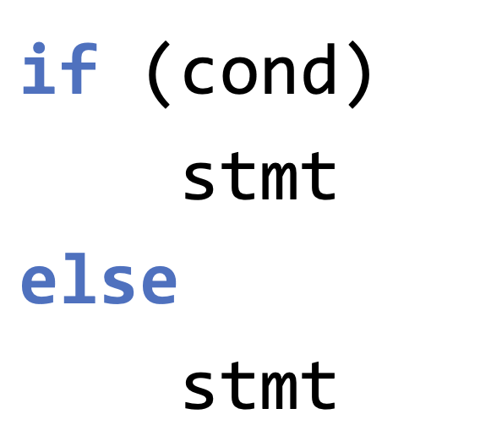
Selection (Decision Making)
Choose between different paths
Two types:
Two-way: if / else
Multi-way: switch, match
Example (C++)
The condition in if is called control expression, usually Boolean
Notes:
Some languages allow:
if (x) // nonzero = true
👉 Can cause bugs

Slide 5
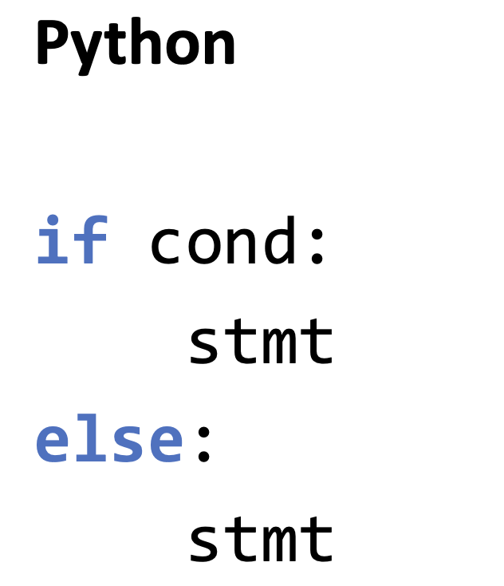
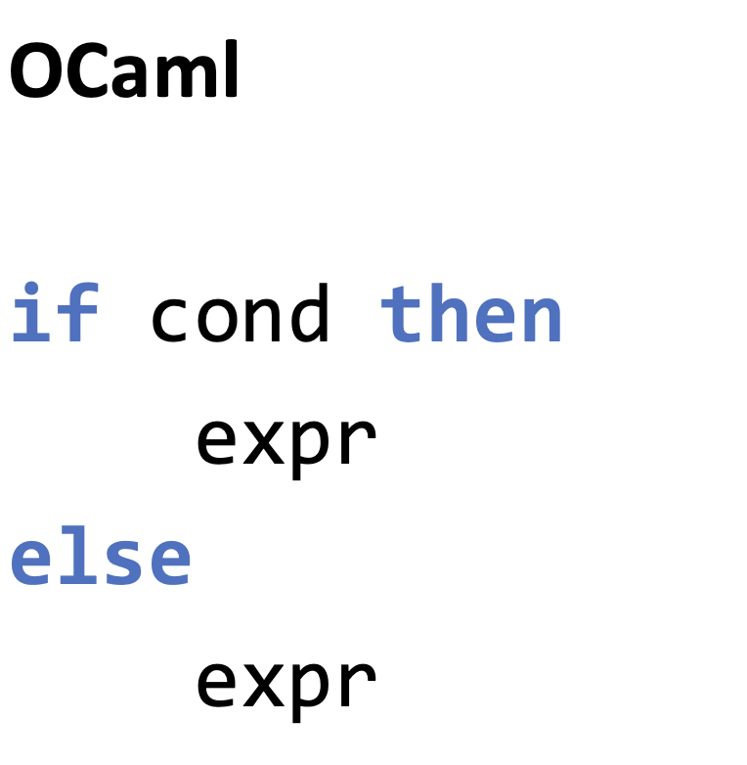
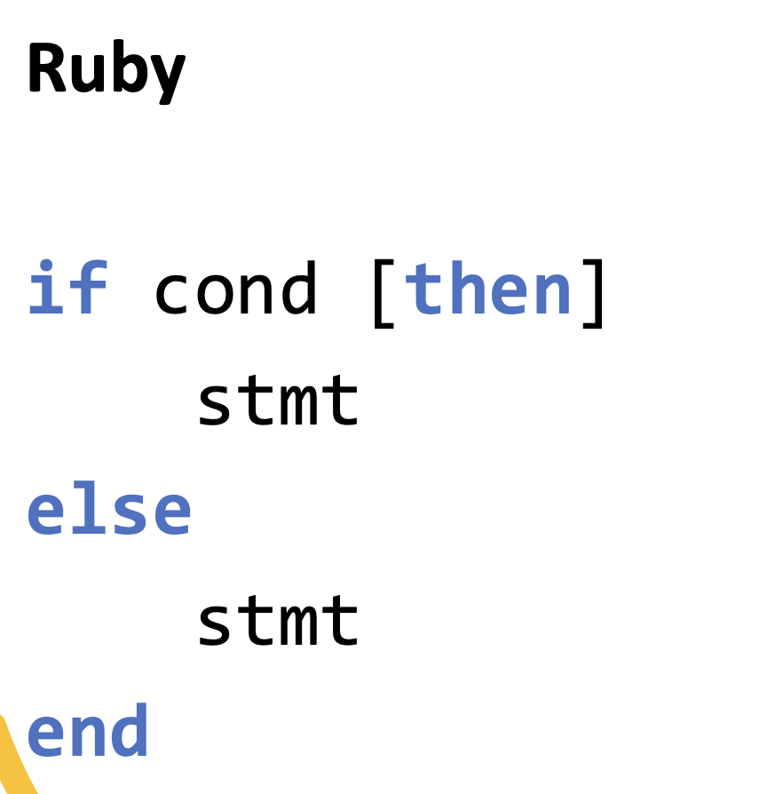

Slide 6
Nested If
Example (C++):
if (x > 0)
if (x > 10)
y = 2;
else
y = 1;
Which if does else belong to?
Dangling Else Problem
C/C++: else matches the closest unmatched if

Slide 7
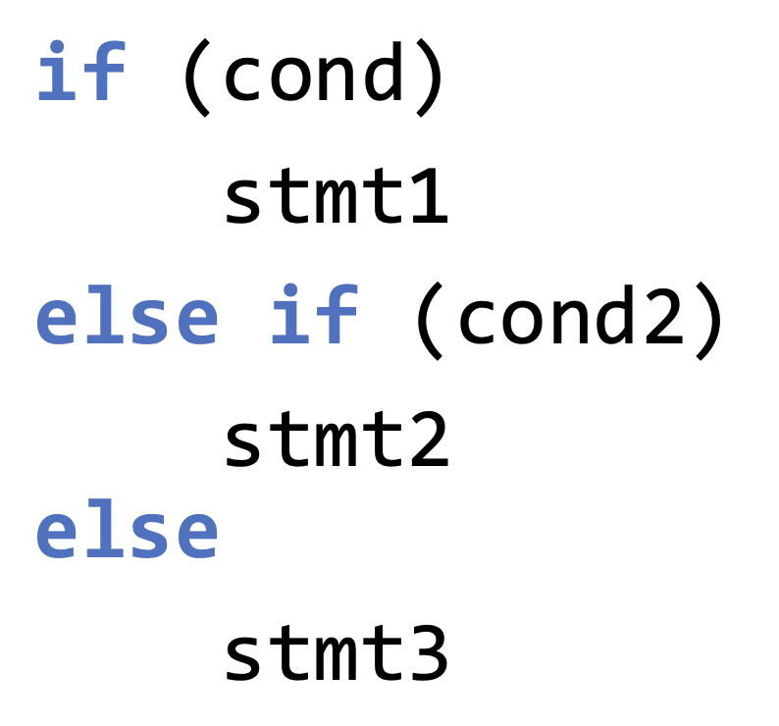
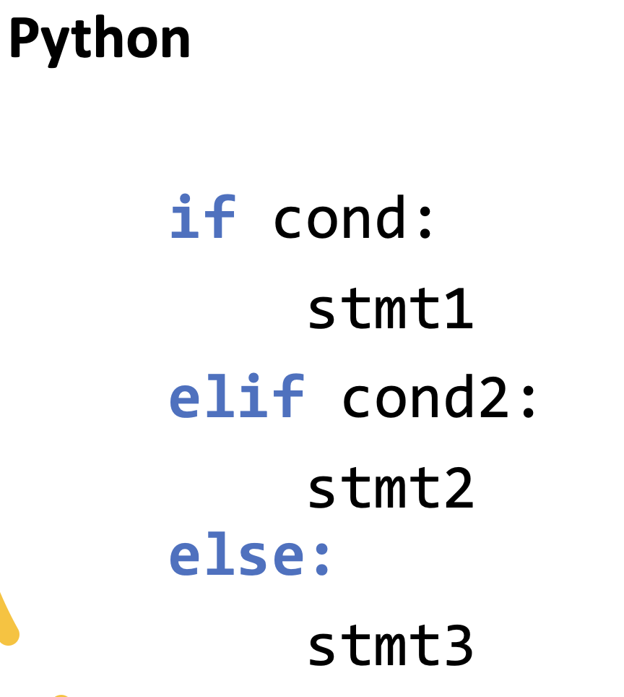
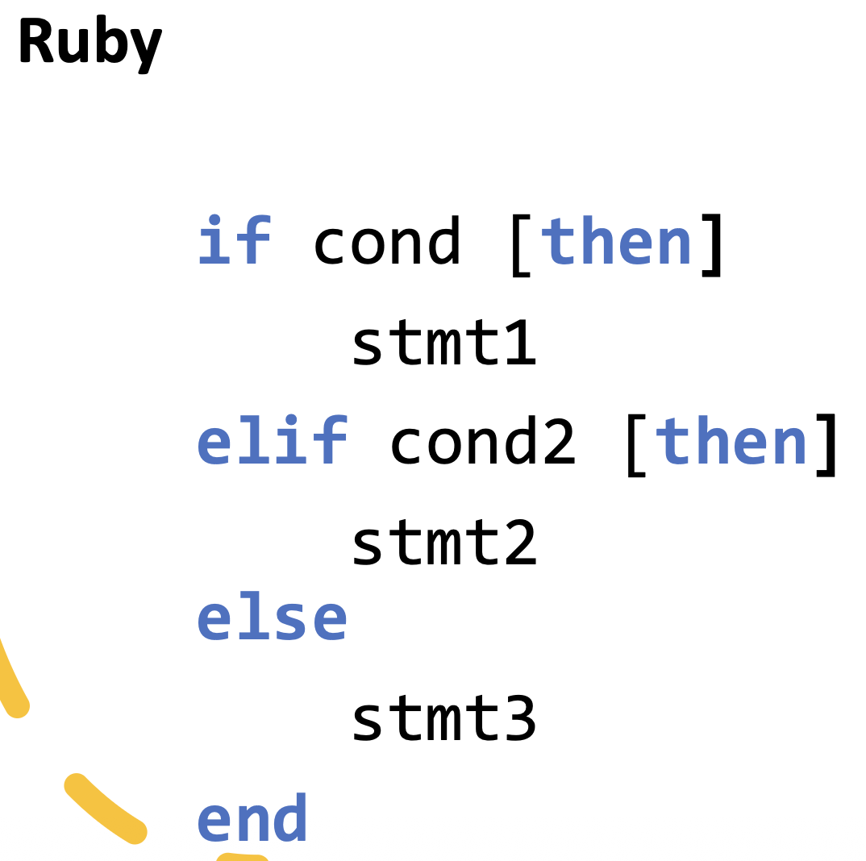
Else-if Chains

Slide 8
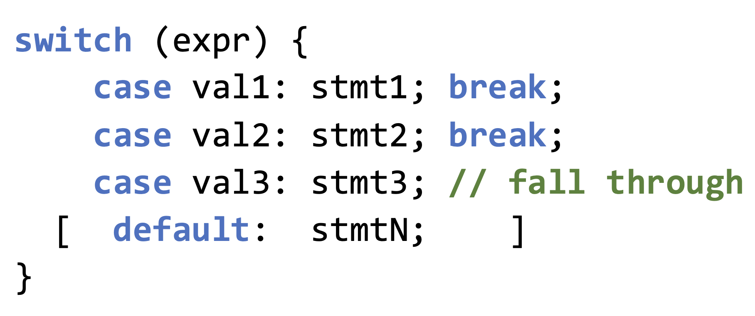
Multi-Way Selection (Switch)
Fall-Through: If no break, execution continues

Slide 9
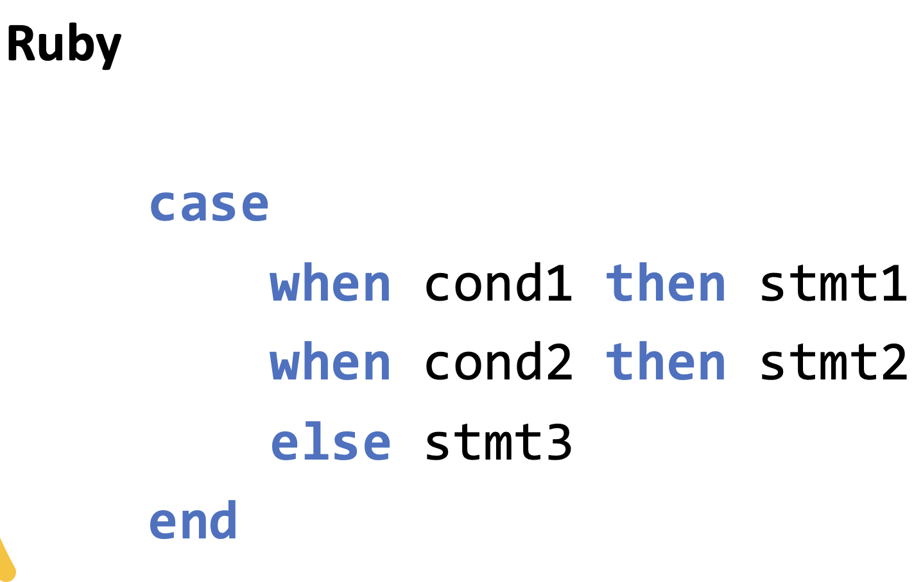
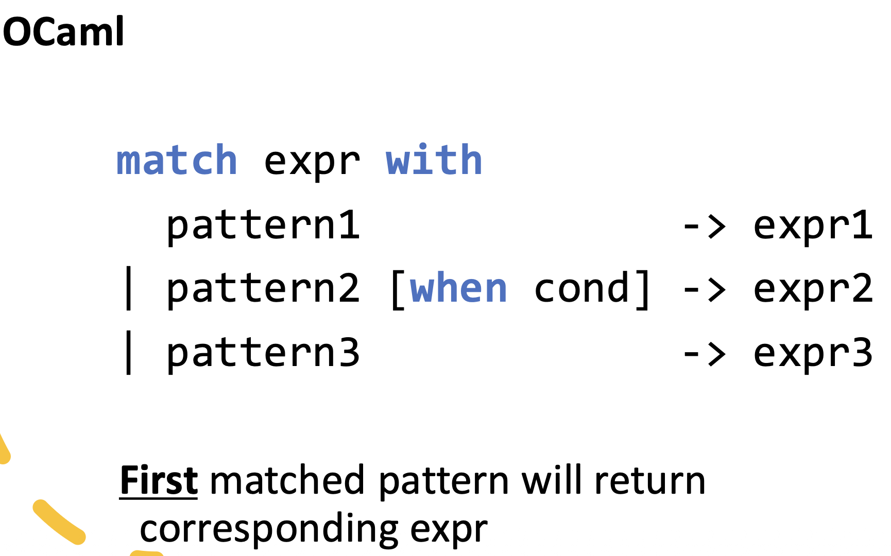
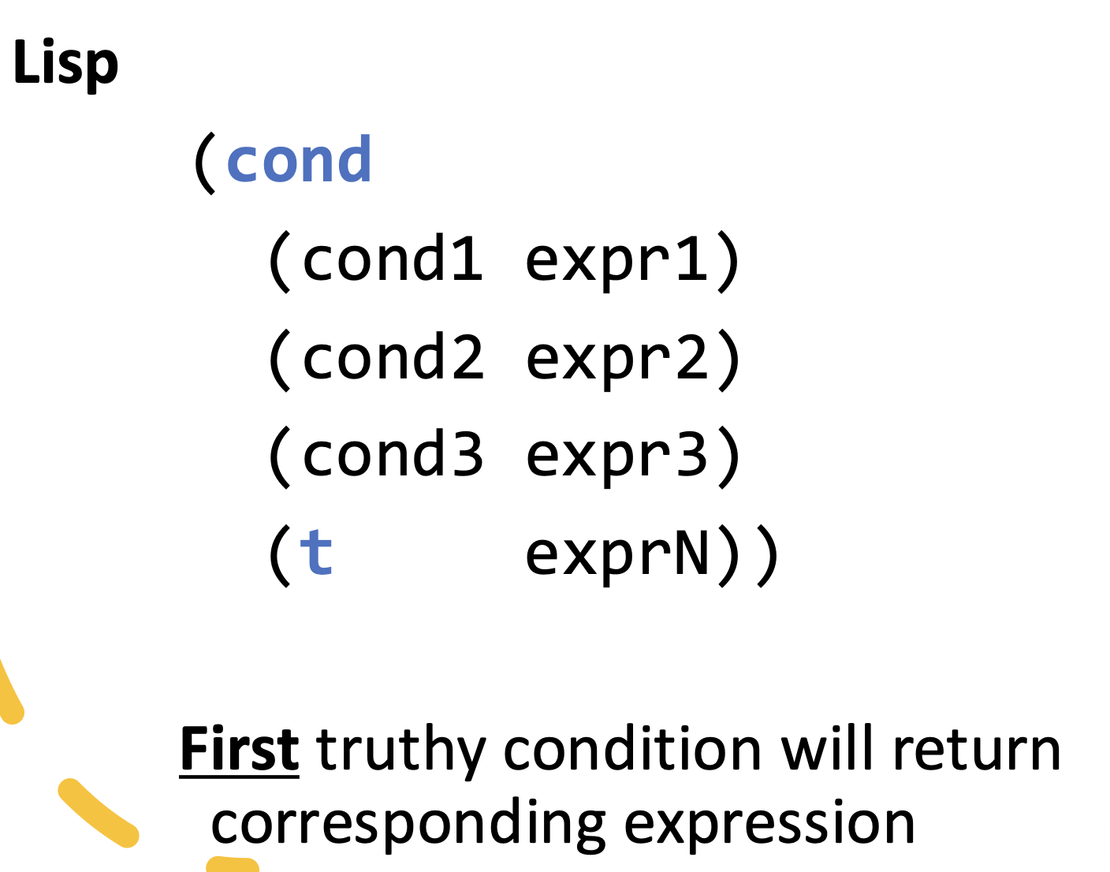

Slide 10
When to Use What
if → general conditions
switch → discrete values
Good for switch: menu options
Not good: complex conditions
Common Mistakes
Missing break
Using assignment in condition: if (x = 3)
Forgetting braces

Slide 11
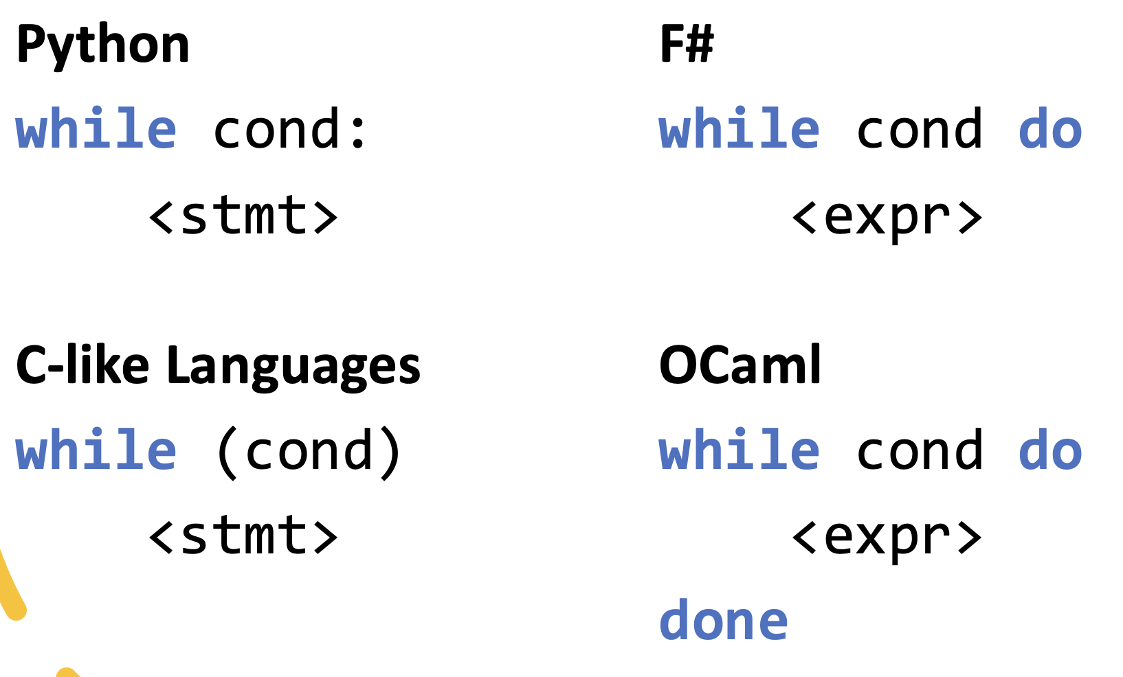
Repetition
Programs often repeat actions
Ways: loops and recursion
While Loops (pre-test loops)

Slide 12
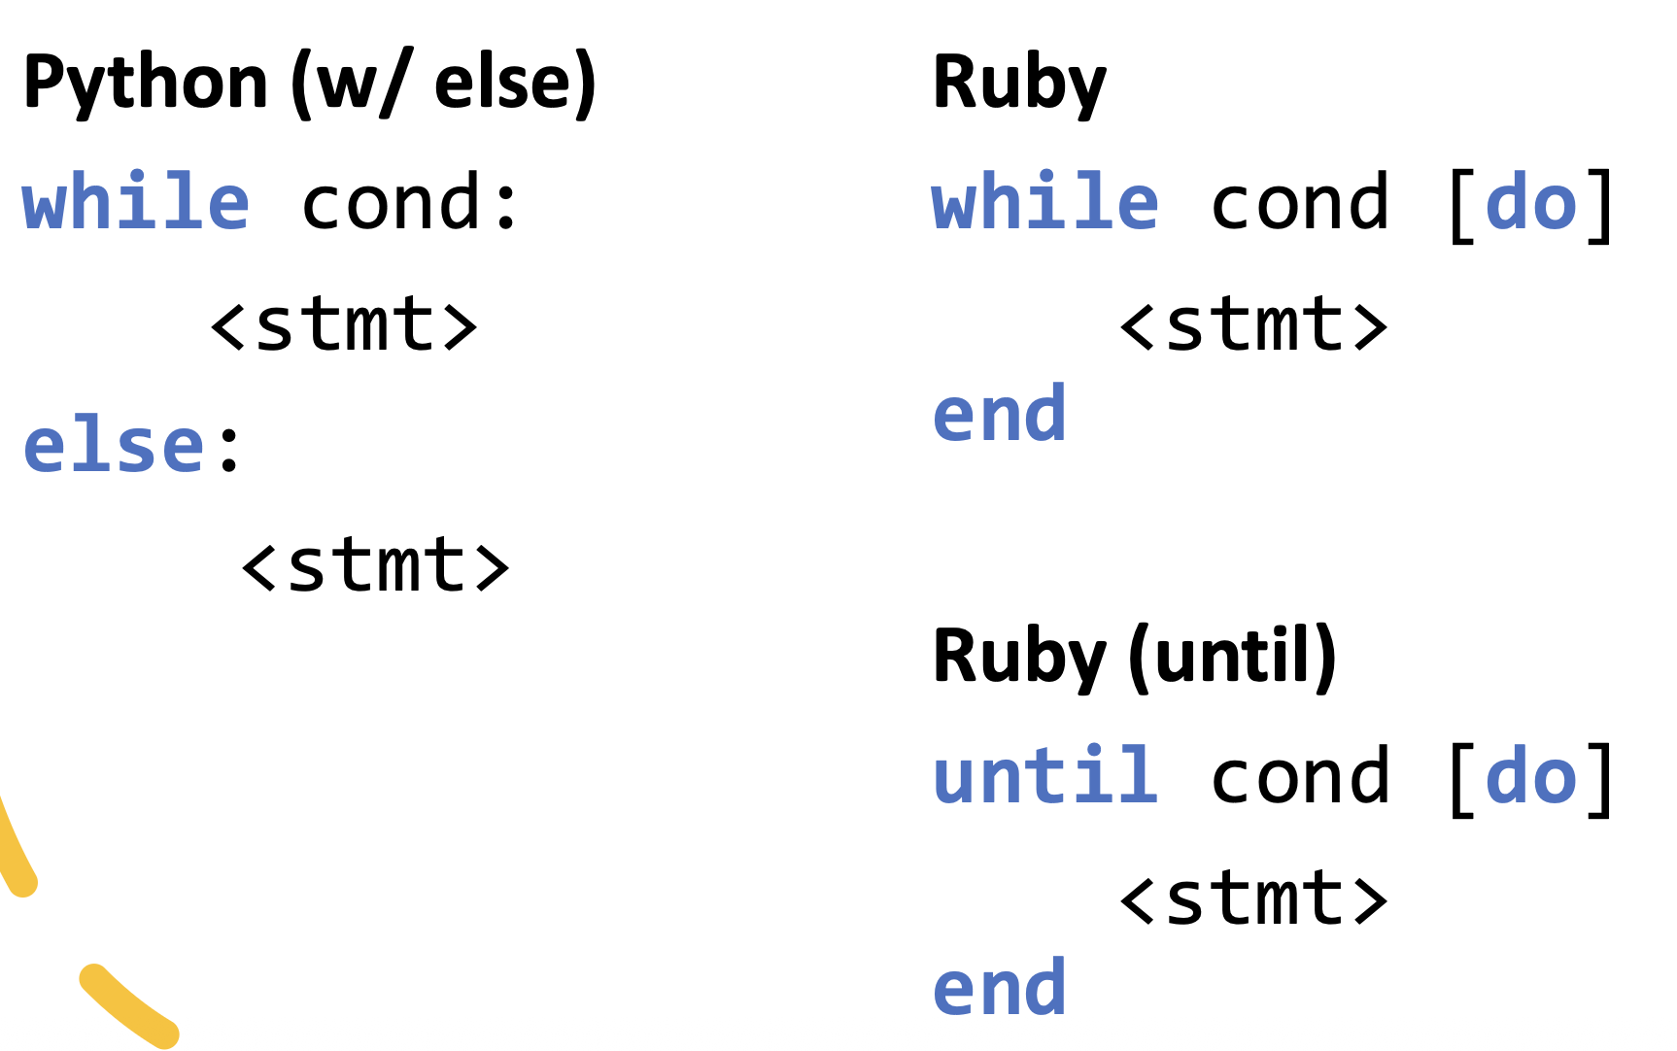
More Pre-test loops

Slide 13
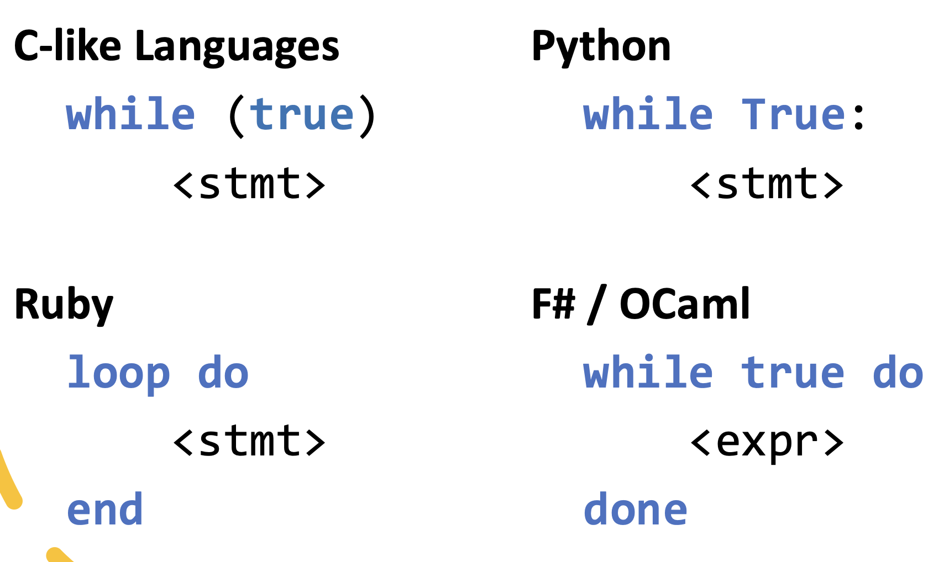
Infinite Loops
Infinite loops must have an exit condition in the loop body

Slide 14
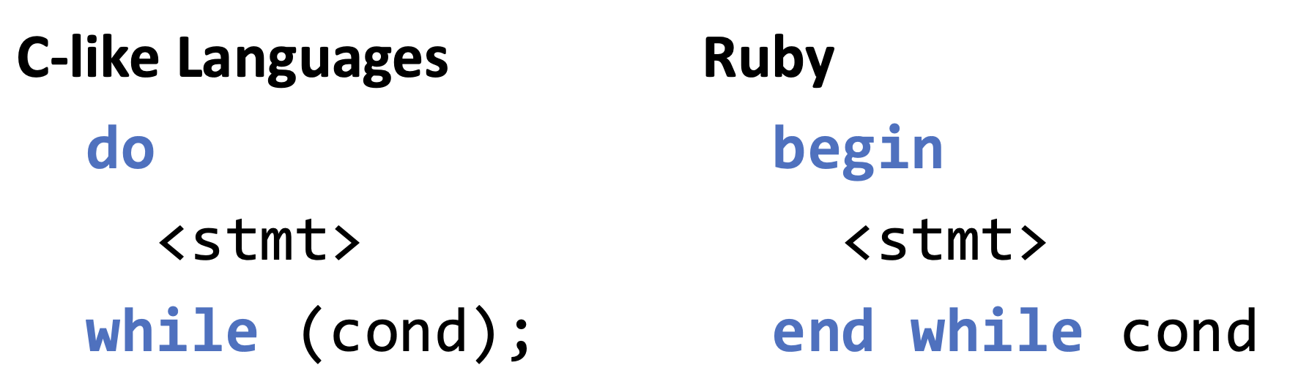
Do-While (Post-test)
Runs at least once
While vs Do-While
while → may run 0 times
do-while → runs at least once
Notes:
How While Works
Check condition
If true → run body
Repeat
👉 If false initially → never runs

Slide 15
For Loop (Counter-Controlled)
for (init; condition; update)
init → once
condition → check each time
update → after each iteration
For-Each Loop
for (int x : arr) cout << x;
Used for collections
while → unknown number of iterations
for → known count
for-each → iterate over collection
Notes:
F
F
T
T
T (hint, no termination, so false -> anything is true)

Slide 16
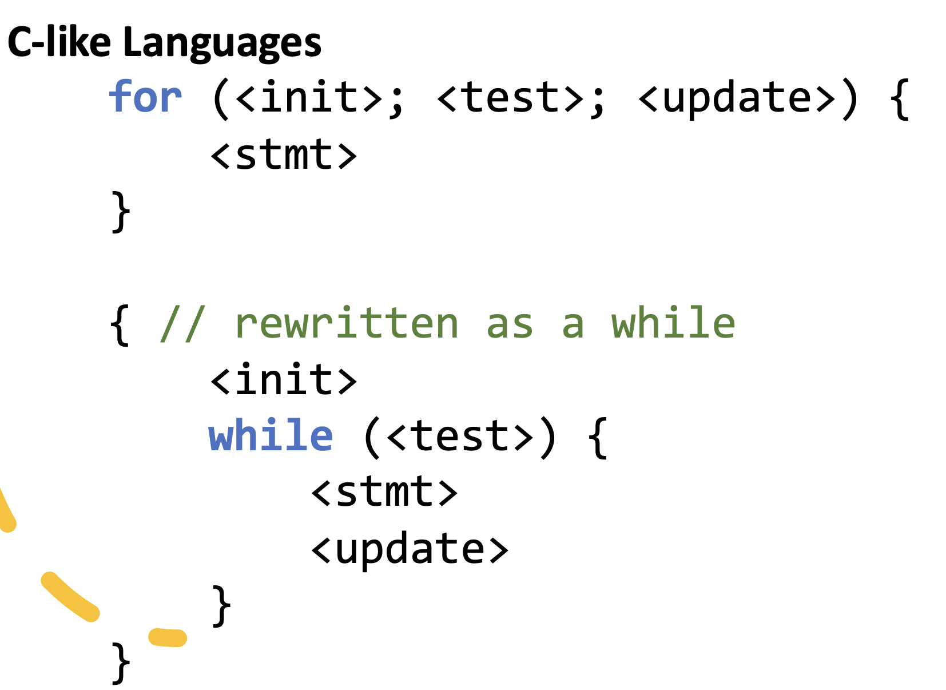
For Loops vs While Loops

Slide 17
Break, Continue, and Goto
Break: exits a loop/control structure immediately
Continue: skips current iteration
E.g.,
for (int x : arr) { if (x > 10) continue; sum += x; }
Goto: Direct mapping to low-level assembly instructions
Avoid goto, make code hard to understand

Slide 18
Structured Programming
Any program can be built from:
Sequence
Selection
Iteration
These are the foundations of programming

